Slide 1
Software Requirement Concepts
Instructor: <Name>

Slide 2
Agenda
Requirement Concepts
Requirement Modeling
Modeling Tools

Slide 3
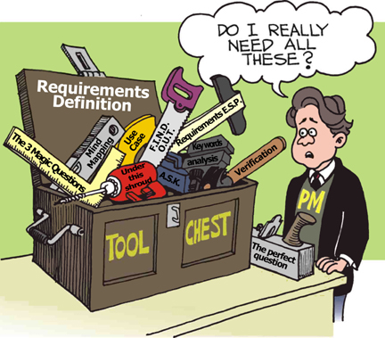
Requirement Concepts Requirement Definition
What is requirement?
A statement of a service the system must do OR
A statement of a constraint the system must satisfy
Notes:
A statement of a service the system must do
Example: the user shall be able to add a new contact to the address book
OR
A statement of a constraint the system must satisfy
Example: a search on contacts shall return a result in no more than 2 seconds
(1) A condition or capability needed by a stakeholder2 to solve a problem or achieve an
objective.
(2) A condition or capability that must be met or possessed by a system or system
component to satisfy a contract, standard, specification, or other formally imposed
documents.
(3) A documented representation of a condition or capability as in (1) or (2).

Slide 4
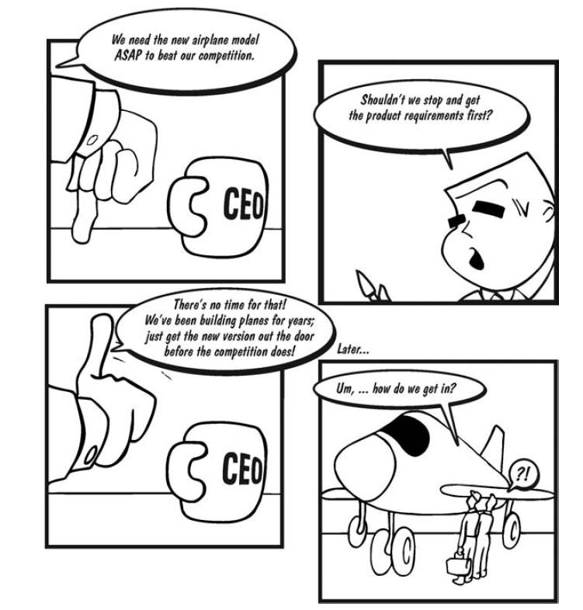
Requirement Concepts Requirement Definition
Why do we need requirements?
Notes:
Question: when do you need to define requirements?

Slide 5
Requirement Concepts Requirement Definition
Purpose of requirement:
Requirements often serve as:
The basis for a bid for a contract - therefore must be high-level to open for interpretation
The basis for the contract itself - therefore must be detailed
Thus, requirements can be high-level or detailed
What are not Requirements
Design or implementation details (other than known constraints)
Project planning information
Testing information

Slide 6
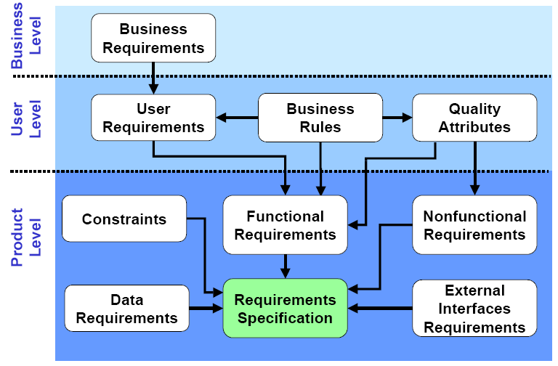
Requirement Concepts Requirements Classification 1/4
Notes:
Business level
Define business problems to be solved or business opportunities to be addressed by the software product
Define why the software product is being developed
Eg. HCVS offers customers an element of on-line fleet management, reporting and driver functionality, branded Capital Control. Linked to Capital Control are a number of bespoke customer driver web sites that have general driver information (for example car policy).
This offering has been developed and live for a number of years and was initially market leading. Over the past few years the competitors have developed better on-line capability that has leapfrogged the HCVS proposition.
This objective of the project is to provide a web-based eCommerce application and data warehouse to supersede Capital Control and Online Quoting tool and retake the market lead.
To achieve this business objective, the project will focus on the user experience.
User level (URD - could be use as part of a RFP (Request For Proposal) to open for contract bidding)
High-level descriptions of the system services and constraints
Focus on system’s functionality from user’s perspective
Define what system shall provide to achieve users’ objectives
Multiple user requirements to fulfill a single business requirements
Business rules are specific policies defining how users do business
Primarily for end-users and written in natural language (avoid technical terminologies) plus diagrams
Product level (Software requirement – SRS, ould be use as part of a contract between client and contractor)
Detailed descriptions of the system services and constraints
Specify functionality that must be built into the software to accomplish users’ tasks
Multiple product-level requirements to fulfill a single user-level requirements
Primarily for engineers to start design
Written in structured natural plus diagrams and math notations

Slide 7
Requirement Concepts Requirements Classification 2/4
Requirement may be classified as
Functional
A service the system has to perform
May include information the system must contain
Non-functional
A constraints the system must satisfy
Notes:
Non-functional may be
Law (system must follow law of labor, regulators, policies)
Industry standard
Security
Safety
Mobility
Maintainability
…

Slide 8
Requirement Concepts Requirements Classification 3/4
Sample of functional requirement
The “Data Entry Module” should provide the following functionality:
Data Entry for HR: allows HR staff to enter payroll data and the like, either via web-based forms or by importing data from Excel files
Data Entry for Regional offices: allows the PGB’s regional offices to enter billing data, either via web-based forms or by importing data from Excel files

Slide 9
Requirement Concepts Requirements Classification 4/4
Sample of non-functional requirement
Product requirements
Requirements which specify that the delivered product must behave in a particular way
Categories: performance, reliability, usability, security, cultural, etc.
Organisational requirements
Requirements which are a consequence of organisational policies and procedures
Categories : technology, process , operation, time, budget, etc.
External requirements
Requirements which arise from factors which are external to the system and its development process
Categories : interoperability requirements, legislative requirements, etc.

Slide 10

Requirement Modeling Modeling objectives
Why model requirement?
To understand clearly the functionalities of system
To present the system from different perspectives
Notes:
Key point
System modelling helps the analyst to understand the functionality of the system and models are used to communicate with customers.
Different models present the system from different perspectives
External perspective showing the system’s context or environment;
Behavioural perspective showing the behaviour of the system;
Structural perspective showing the system or data architecture.

Slide 11
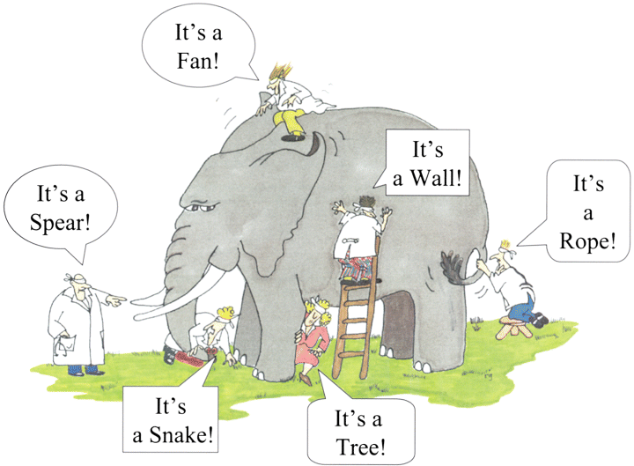
Requirement Modeling Model different perspectives
Model different perspectives
Models help present different aspects of the system, using different abstraction
Notes:
That is why we need common way to model requirement

Slide 12
Requirement Modeling System Modeling Tools
The system modeling presents an abstraction of the system in software aspects, which helps understanding of the functional requirements in block diagram form, and helps to identify all required software elements & tasks.
Common modeling tools:
Use case
Data flow diagram
Behavioural
model
Object model
Sequence diagram
Aggregation
Activity diagram
State machine diagram
Inheritance
Notes:
By the way of developing of OOA, we only introduce detail about Use case
The Dynamic (Behavioral) Model
The Static (Structural) Model

Slide 13
Modeling Tools - Use Case
Requirements capture
Requirements are reason-for-existence of any software development project
Defines and delineates user-requirements
Defines the functionality to be provided
Identifies the goals to be achieved
Must be precisely and completely understood
Requirements often changes, thus must be well-documented
Notes:
A use case is a use to which the system will be put as someone or something interacts with it. The description of the use case should describe the series of steps that take place during the interaction and include different ways that this interaction could play out.\

Slide 14
Modeling Tools - Use Case
Requirement capture with UML
Use Case diagram
Shows a set of use cases, actors and their relationships
Captures problem-domain in terms of:
functionality to be provided (Use Cases)
the “roles” (Actors) for whom these functions are performed

Slide 15
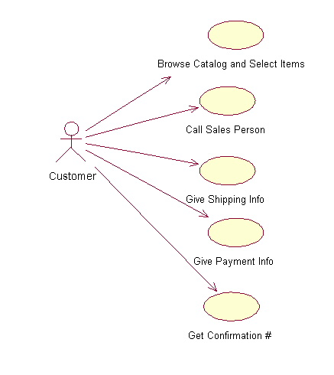
Modeling Tools - Use Case Use Case Diagram
Actor
overview the usage requirements
presentations project stakeholders
"the meat" of the actual requirements
Use case:
A use case describes a sequence of actions that provide something of measurable value to an actor and is drawn as a horizontal ellipse
System boundary:
indicates the scope of your system. Anything within the box represents functionality that is in scope and anything outside the box is not
Actor:
An actor is a person, organization, or external system that plays a role in one or more interactions with your system
Use case
Online C2C shopping
System boundary
Notes:
Use case definition
An abstraction of a set of sequences of actions that yields some functionality
Represents some user-visible function.
Always initiated by an “actor”
Describes the interaction between the actors and the system for a system function
Achieves a discrete goal for the actor
Finding use cases
What functions does the system perform?
What functions do the “actors” require?
What input/output does the system need?
What verbs are used to describe the system?
The Reservation Clerk makes a booking using the system, based on the...
The Airport Manager can make an entry for a new flight. He can also modify flight details ...
Actor
A role that interacts with the system
Represents a role, not individuals
can be a person, a device, or another system
Communicate with the system by sending, receiving messages
May participate in many use cases; a use case may have several actors participating in it
Finding actors
Who uses the main functionality of the system?
Which hardware devices the system needs to handle?
Which other external systems does the system need to interact with?
Identify nouns/subjects used to describe the system
The Reservation Clerk makes a booking using the system, based on the...
A user must login in order to save his itinerary

Slide 16

Modeling Tools - Use Case Use Case Diagram - Notations
Use case diagram: Notations
use case
A description of a set of sequences of actions that system performs that provides an observable value to an actor
Do it
actor
The people or systems that provide or receive information from the system; they are among the stakeholders of a system
include
Specifies that the source use case explicitly incorporates the behavior of another use case at a location specified by the source
<<include>>
extend
Specifies that the target use case extends the behavior of the source.
<<extend>>

Slide 17
Modeling Tools - Use Case Example - Use Case 1/2
A company wants to develop a ticketing and reservation system. This must support advance booking of tickets, cancellation of tickets and change of class of a ticket. All these are handled by a Reservation Clerk.
The system will also have a Web site where users can register themselves and purchase tickets online. They can pay either by using their online banking account or by credit card. Reservations made over the internet can only be cancelled across the counter.
The system will also have a querying facility that allows users to check train time-tables, fares and availability of tickets.
Use case example
A company wants to develop a ticketing and reservation system. This must support advance booking of tickets, cancellation of tickets and change of class of a ticket. All these are handled by a Reservation Clerk.
The system will also have a Web site where users can register themselves and purchase tickets online. They can pay either by using their online banking account or by credit card. Reservations made over the internet can only be cancelled across the counter.
The system will also have a querying facility that allows users to check train time-tables, fares and availability of tickets.
Notes:
Use case definition
An abstraction of a set of sequences of actions that yields some functionality
Represents some user-visible function.
Always initiated by an “actor”
Describes the interaction between the actors and the system for a system function
Achieves a discrete goal for the actor
Finding use cases
What functions does the system perform?
What functions do the “actors” require?
What input/output does the system need?
What verbs are used to describe the system?
The Reservation Clerk makes a booking using the system, based on the...
The Airport Manager can make an entry for a new flight. He can also modify flight details ...
Actor
A role that interacts with the system
Represents a role, not individuals
can be a person, a device, or another system
Communicate with the system by sending, receiving messages
May participate in many use cases; a use case may have several actors participating in it
Finding actors
Who uses the main functionality of the system?
Which hardware devices the system needs to handle?
Which other external systems does the system need to interact with?
Identify nouns/subjects used to describe the system
The Reservation Clerk makes a booking using the system, based on the...
A user must login in order to save his itinerary

Slide 18
Modeling Tools - Use Case Example - Use Case 2/2
Make Reservation
Cancel Reservation
Modify Class
Check train time-table
Query Timetable
Check Fare
Register as Member

Slide 19
Modeling Tools - Use Case Example - Use Case Diagram
Use case diagram
Modify Class
Check Fare
Query Timetable
Reservation Clerk
Passenger
Make Reservation
Cancel Reservation
Register as Member
Check train time-table

Slide 20

Modeling Tools - DFD
DFD = Data Flow Diagram
How data is processed by system
How data flows through a sequence of processing steps
Notes:
Data flow diagrams (DFDs) may be used to model the system’s data processing.
These show the processing steps as data flows through a system.
DFDs are an intrinsic part of many analysis methods.
Simple and intuitive notation that customers can understand.
Show end-to-end processing of data.
A data flow diagram (DFD) is a graphical representation of the "flow" of data through a system. DFDs can also be used for the visualization of data processing (structured design).

Slide 21
Modeling Tools – DFD Sample DFD
process
Checked and signed order +order notification
Completed order
Signed order form
Signed order form
Send to supplier
Order detail + blank order form
Complete order form
Validate order
Record
order
Signed order form
Adjust available budget
data
Order
detail
Order amount +account detail
flow
Orders
file
Budget
file
Data stores
Notes:
This model shows the steps involved in processing an order for goods (such as computer equipments) in an organization.
The model shows how the order for the goods moves from process to process.
It also shows the data stores (Orders file and Budget file) that are involved in this process
DFDs model the system from a functional perspective.
Tracking and documenting how the data associated with a process is helpful to develop an overall understanding of the system.
Data flow diagrams may also be used in showing the data exchange between a system and other systems in its environment.

Slide 22
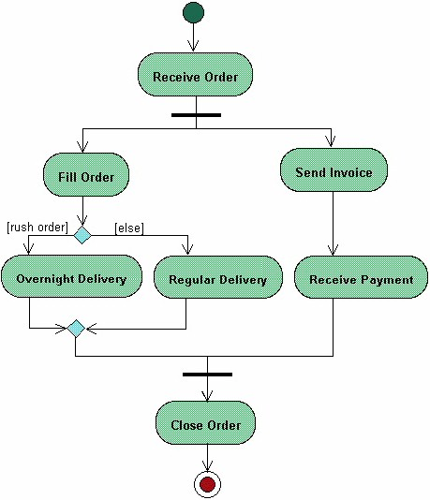
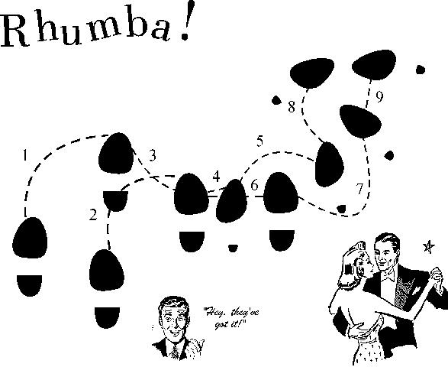
Modeling Tools - Activities Diagram
Start
Activity diagrams describe the workflow behaviour of a system including a sequence of activities performed from start to finish
Fork
Activities could be performed:
- sequential order
- parallel
- conditional transition
Branch
Merge
Joint
End
Notes:
Activity diagrams describe the workflow behavior of a system. The diagrams describe the state of activities by showing the sequence of activities performed. Activity diagrams can show activities that are conditional or parallel.
Activity diagrams should be used in conjunction with other modeling techniques such as interaction diagrams and state diagrams. The main reason to use activity diagrams is to model the workflow behind the system being designed. Activity Diagrams are also useful for: analyzing a use case by describing what actions need to take place and when they should occur; describing a complicated sequential algorithm; and modeling applications with parallel processes.
However, activity diagrams should not take the place of interaction diagrams and state diagrams. Activity diagrams do not give detail about how objects behave or how objects collaborate.
Initial Node (Start): An initial or start node is depicted by a large black spot, as shown below.
Action represents a single step within an activity. Actions are denoted by round-cornered rectangles.
Control Flow (Transition): A control flow shows the flow of control from one action to the next. Its notation is a line with an arrowhead
Decision (branch) and merge nodes have the same notation: a diamond shape. They can both be named. The control flows coming away from a decision node will have guard conditions which will allow control to flow if the guard condition is met.
Forks and joins have the same notation: either a horizontal or vertical bar (the orientation is dependent on whether the control flow is running left to right or top to bottom). They indicate the start and end of concurrent threads of control. The following diagram shows an example of their use.
Forks and joins have the same notation: either a horizontal or vertical bar (the orientation is dependent on whether the control flow is running left to right or top to bottom). They indicate the start and end of concurrent threads of control.
A join is different from a merge in that the join synchronizes two inflows and produces a single outflow. The outflow from a join cannot execute until all inflows have been received. A merge passes any control flows straight through it. If two or more inflows are received by a merge symbol, the action pointed to by its outflow is executed two or more times
Final Node (End): There are two types of final node: activity and flow final nodes. The activity final node is depicted as a circle with a dot inside (see the slide), The flow final node is depicted as a circle with a cross inside.

Slide 23
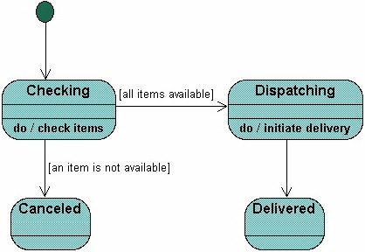
Modeling Tools - State Machine
A State Machine diagram
shows the possible states of
the object and the transitions
that cause a change in state.
?
What is different between activities and Statemachine diagram
Notes:
These model the behaviour of the system in response to external and internal events.
They show the system’s responses to stimuli so are often used for modelling real-time systems.
Show system states as nodes and events as arcs between these nodes. When an event occurs, the system moves from one state to another.
A brief description of the actions is included following the ‘do’ in each state.
Can be complemented by tables describing the states and the stimuli.

Slide 24
Q & A

